Slide 1
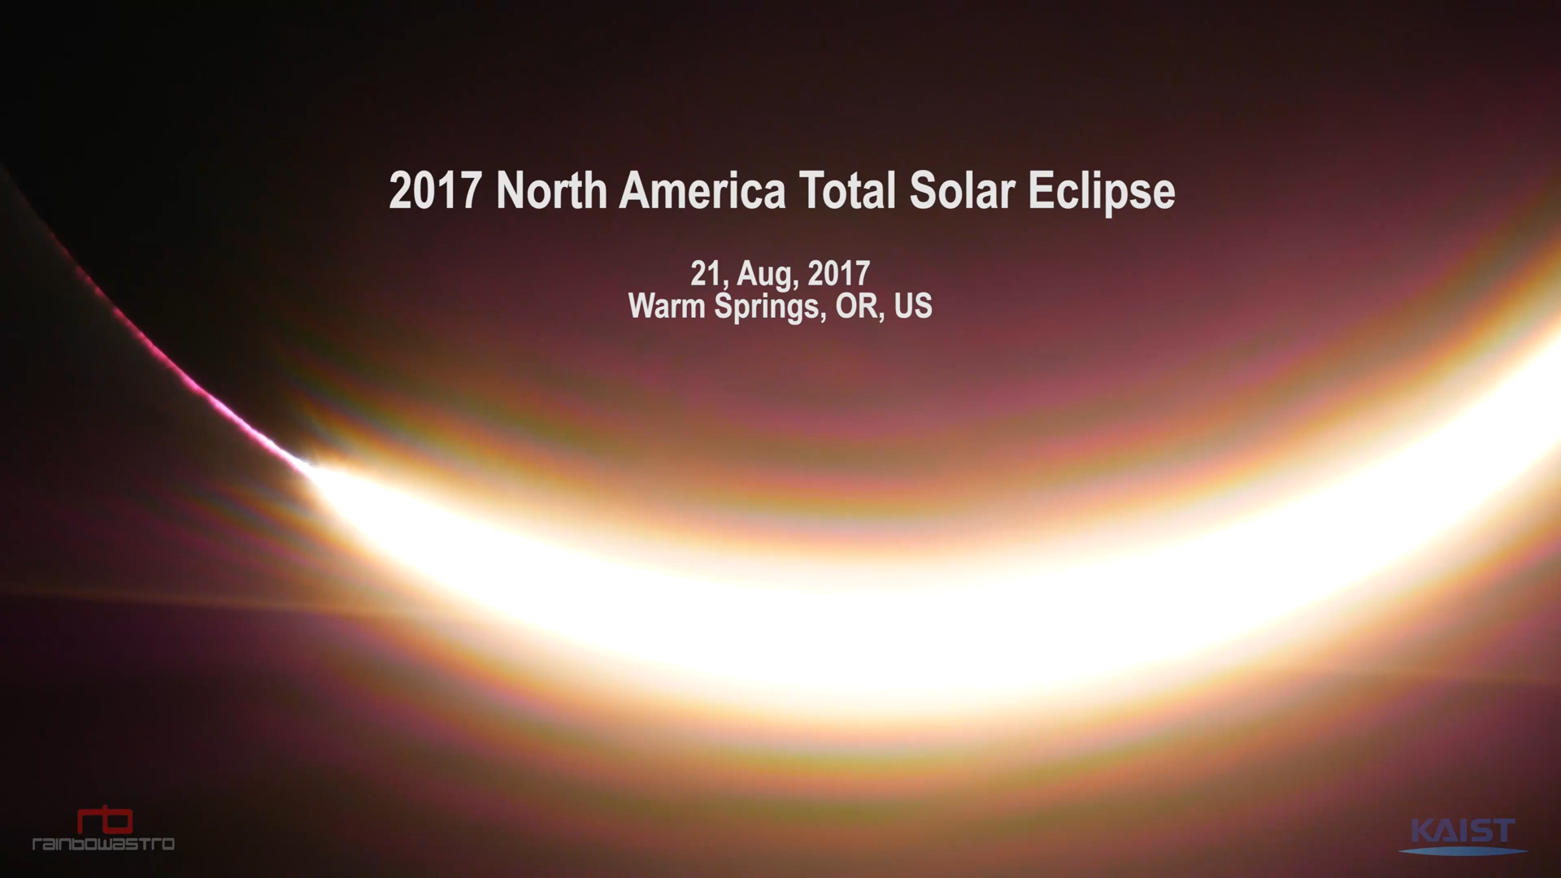
From APOD, September 12, 2017

Slide 2
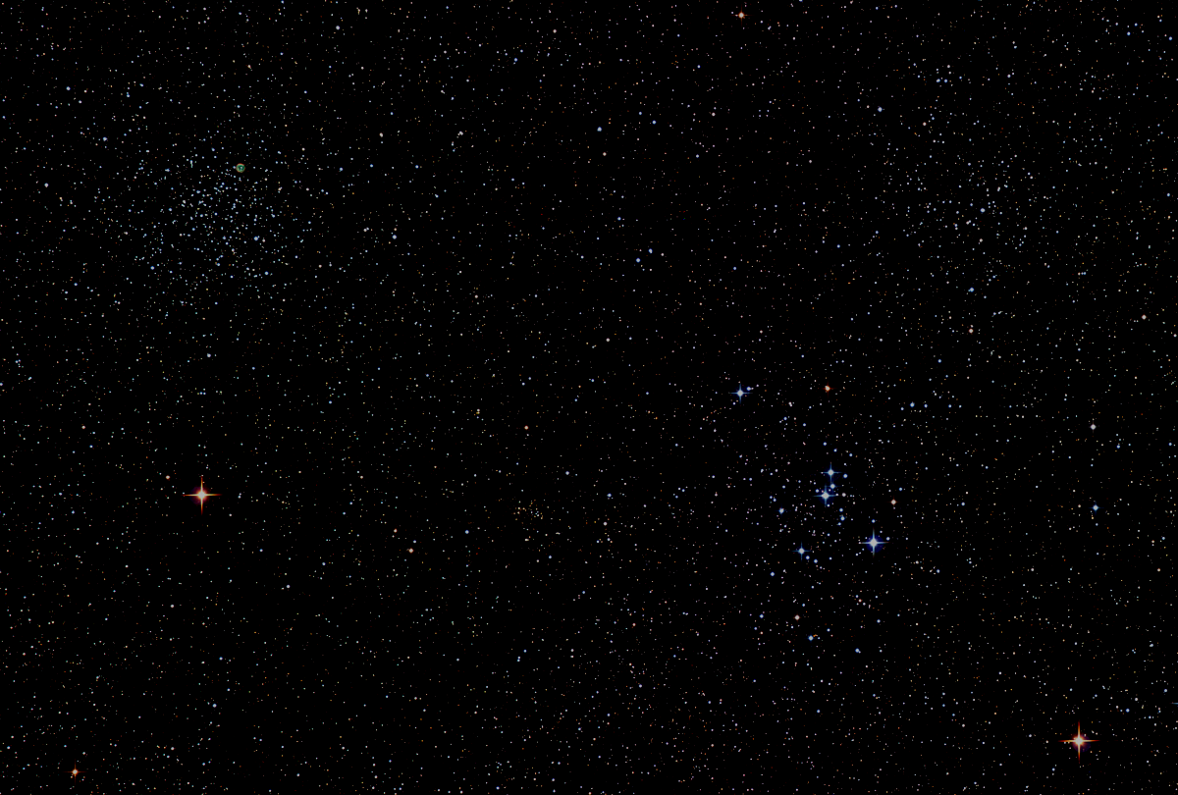

Howard
Astronomical
League
17
September 21st, 2017

Slide 3
Introductions

Slide 4
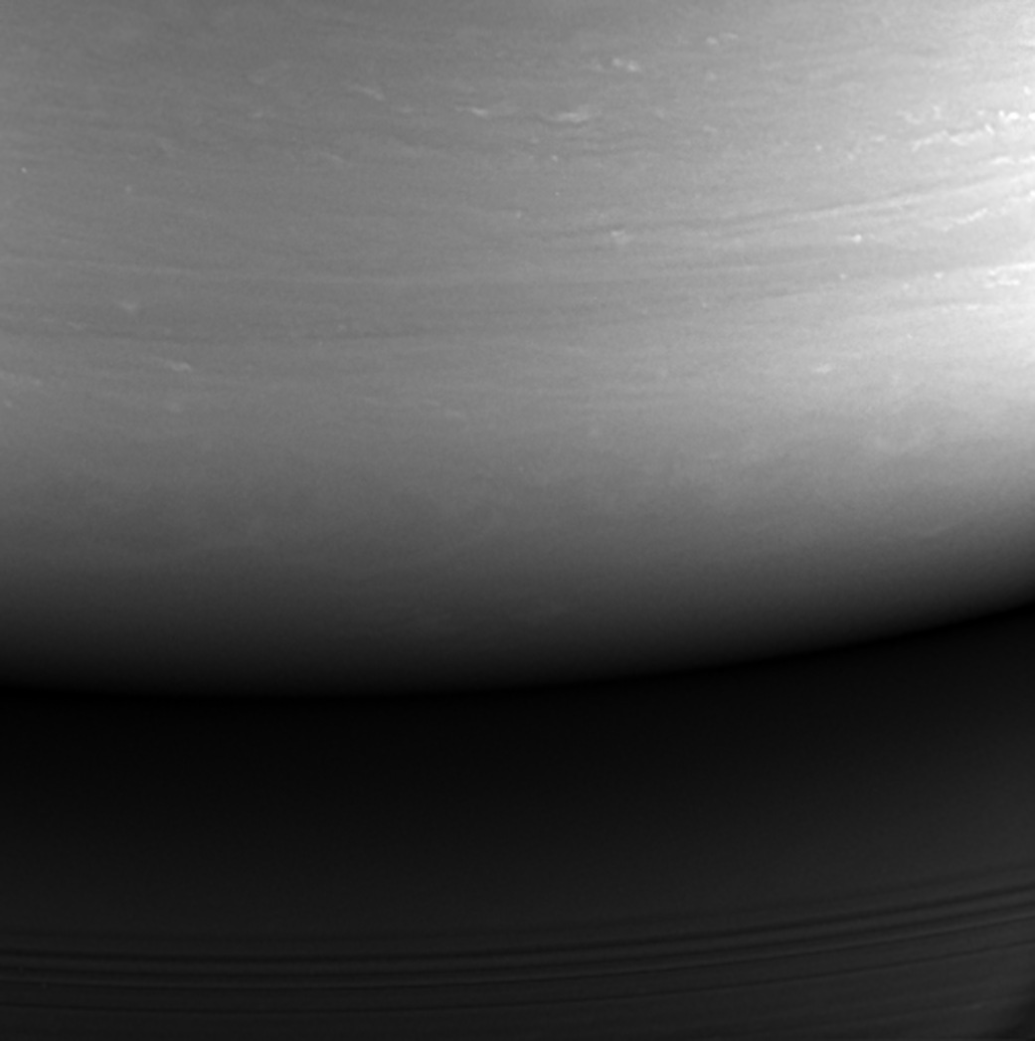
Goodbye Cassini!
Cassini’s final image
September 15, 2017
NASA, JPL-CAL Tech,
and Space Science Institute

Slide 5
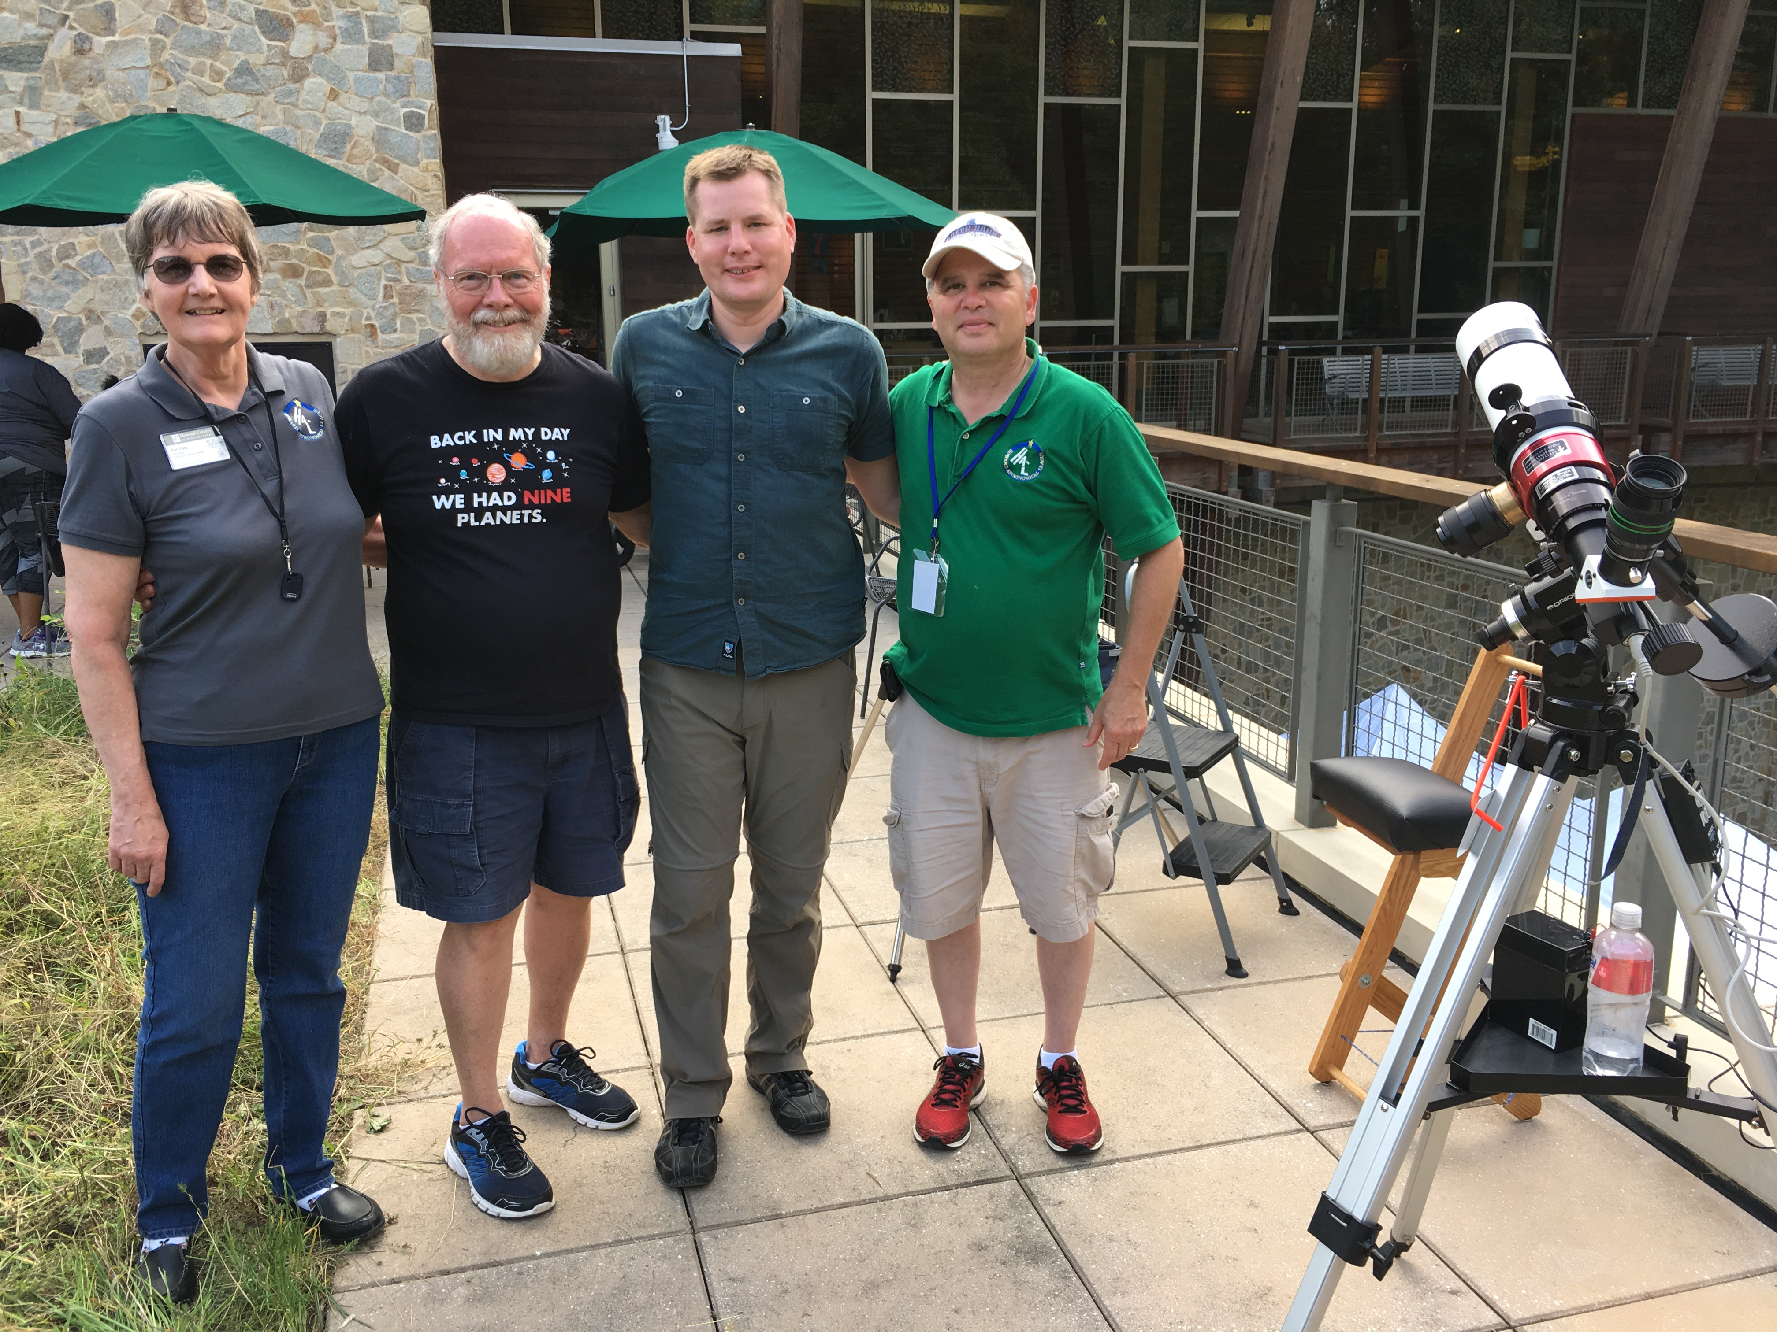
RNC Open House Sunday, September 16th

Slide 6
Upcoming Events
HAL Events – Alpha Ridge Park
Sept 30th at 7pm– Public Star Party
Oct 21st at 6:30pm – Members’ Star Party
Oct 28th at 6pm – Public (STEM) Star Party
Regional Events
Sept 22-24 – Black Forest, Cherry Springs, PA Star Party

Slide 7
NASA Solar System Ambassador Program
Be a NASA public engagement representative
Accepting applications through September 30th for 2018
Application URL: https://solarsystem.nasa.gov/ssa/aoapplication.cfm

Slide 8
This Evening’s Speaker
Jim Johnson
The Great American Eclipse of 2017:
The Collective Experience of the
Howard Astronomical League
Notes:
It is my distinct pleasure to introduce Dr. Bindu Rani. She has been a Postdoctoral Fellow at NASA/Goddard Space Flight Center since July 2016, and will continue to hold that post until June 2019. She was also a Postdoctoral Fellow at the Max-Planck-Institut für Radioastronomie Bonn, Germany from February 2014 to June 2016. She has held visiting scientist and researcher positions at the Korean Very Long Baseline Interferometry Network of the Korea Astronomy and Space Science Institute, and The Gra-dig-nan Bordeaux Nuclear Research Center in France. Dr. Rani has experience in Gamma-ray, X-ray, optical, and radio astronomy. Her optical observational experience includes use of the 1.04 meter telescope at AIRES, Na-in-i-tal, India, and the 1.20 meter telescope at Mount Abu, India.
Among her many achievements, Dr. Rani was awarded the Otto Hahn Medal for outstanding scientific achievements by the Max Planck Society in 2015. She holds Bachelor and Master of Science degrees from University of Delhi and Da-yan-and University, respectively, in India. Last, and certainly not least, Dr. Rani completed her Ph.D at Max-Planck-Institut für Radioastronomie and University of Köln, both in Germany in 2013.

Slide 9
Member’s astrophotos
and sketches

Slide 10
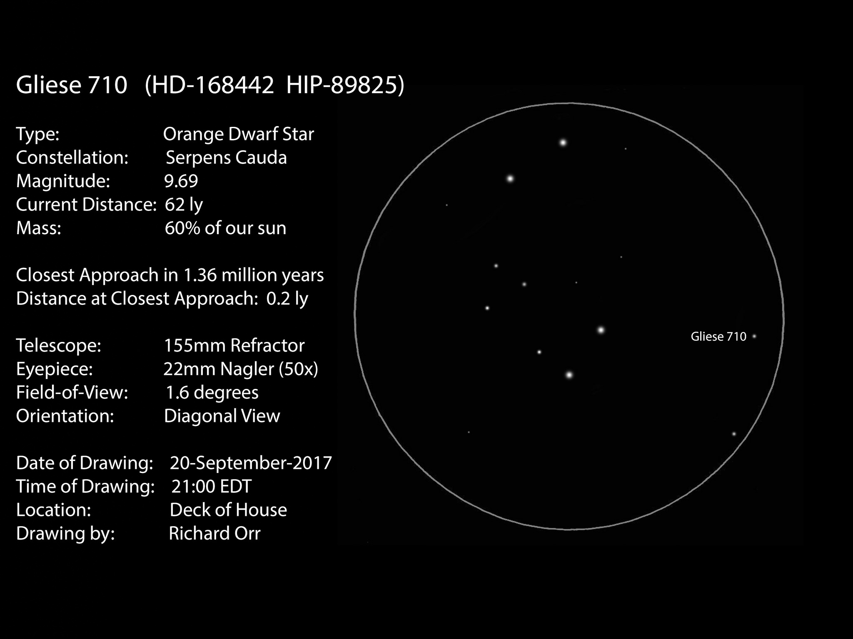
Sketch by Richard Orr, The Doomsday Star

Slide 11
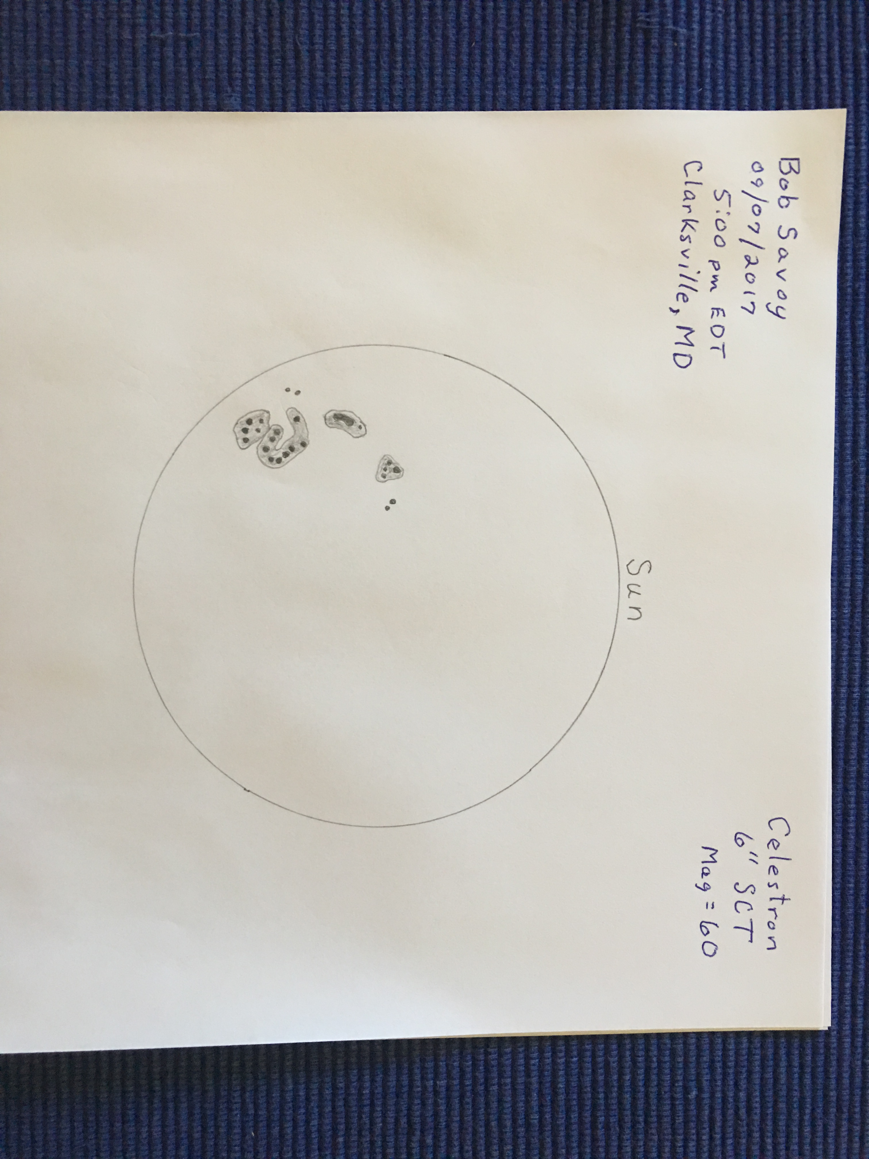
Bob Savoy, Sketch of Sun on September 7, 2017

Slide 12
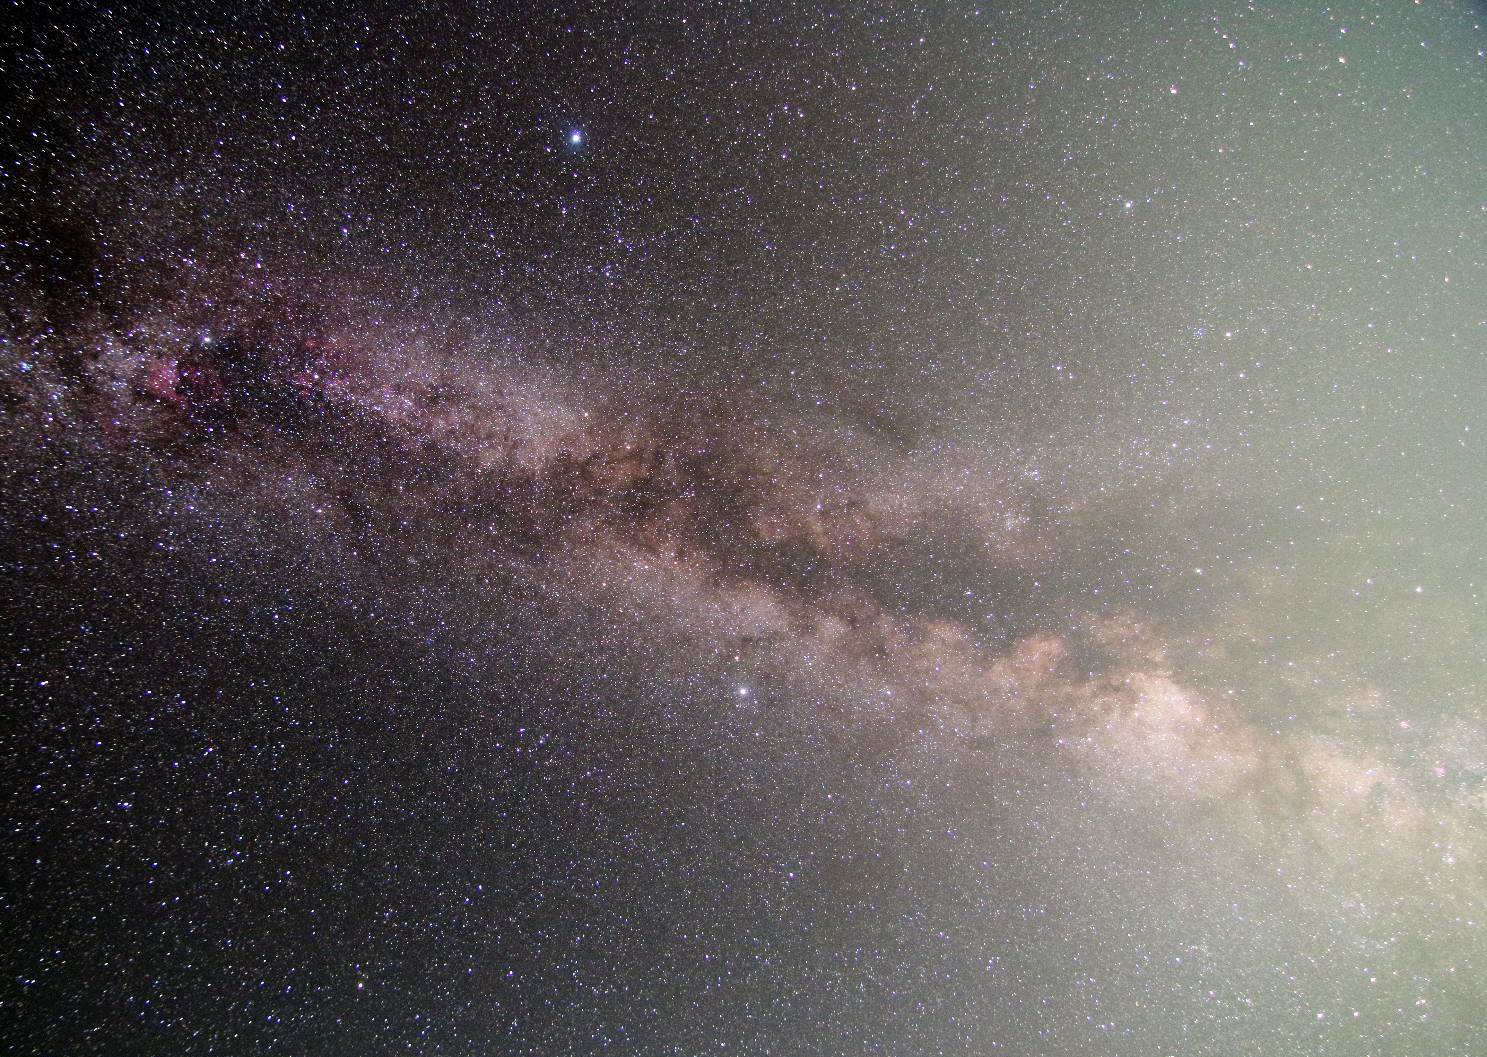
Summer Triangle
Joe Bohannon

Slide 13
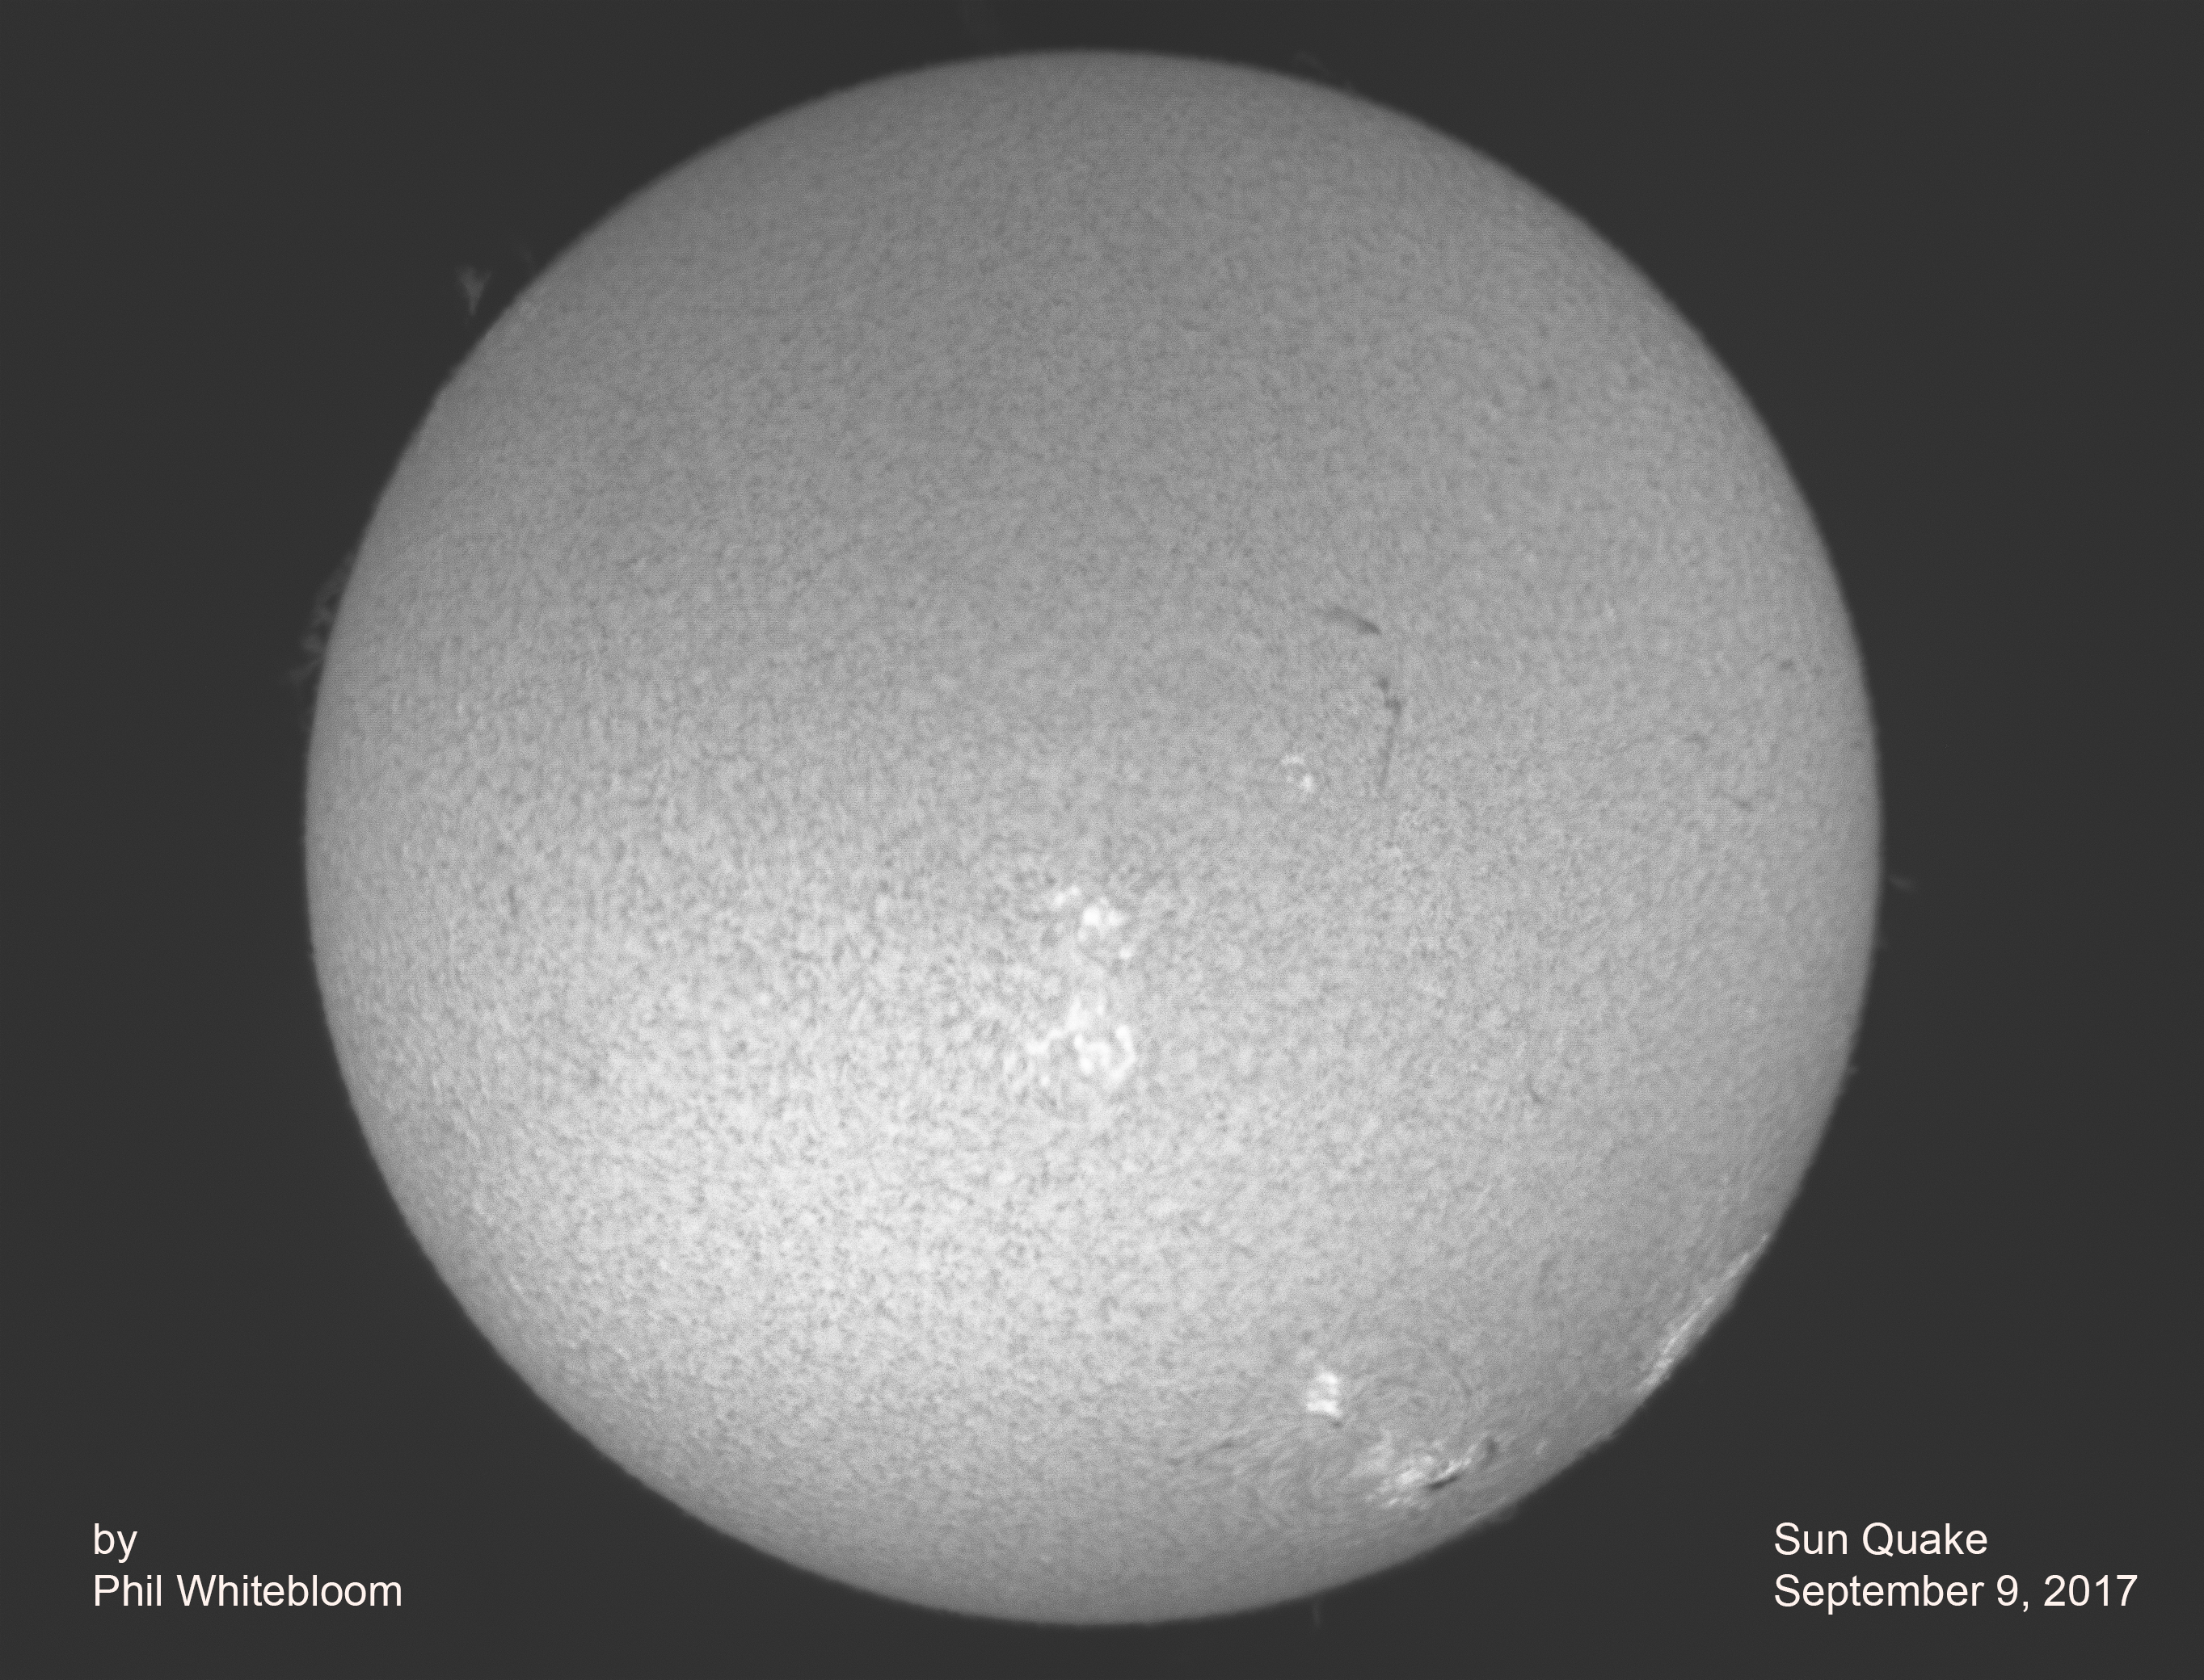
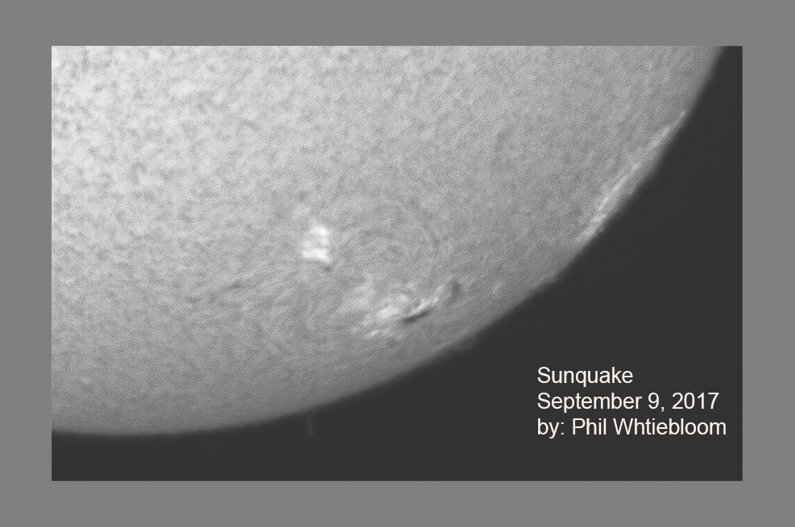

Slide 14
Thank You!
Next month’s meeting is on Thursday, October 19th, 2017 at 7 PM
Dennis Conti
High Precision Exoplanet Observations with Amateur Telescopes

